Slide 1
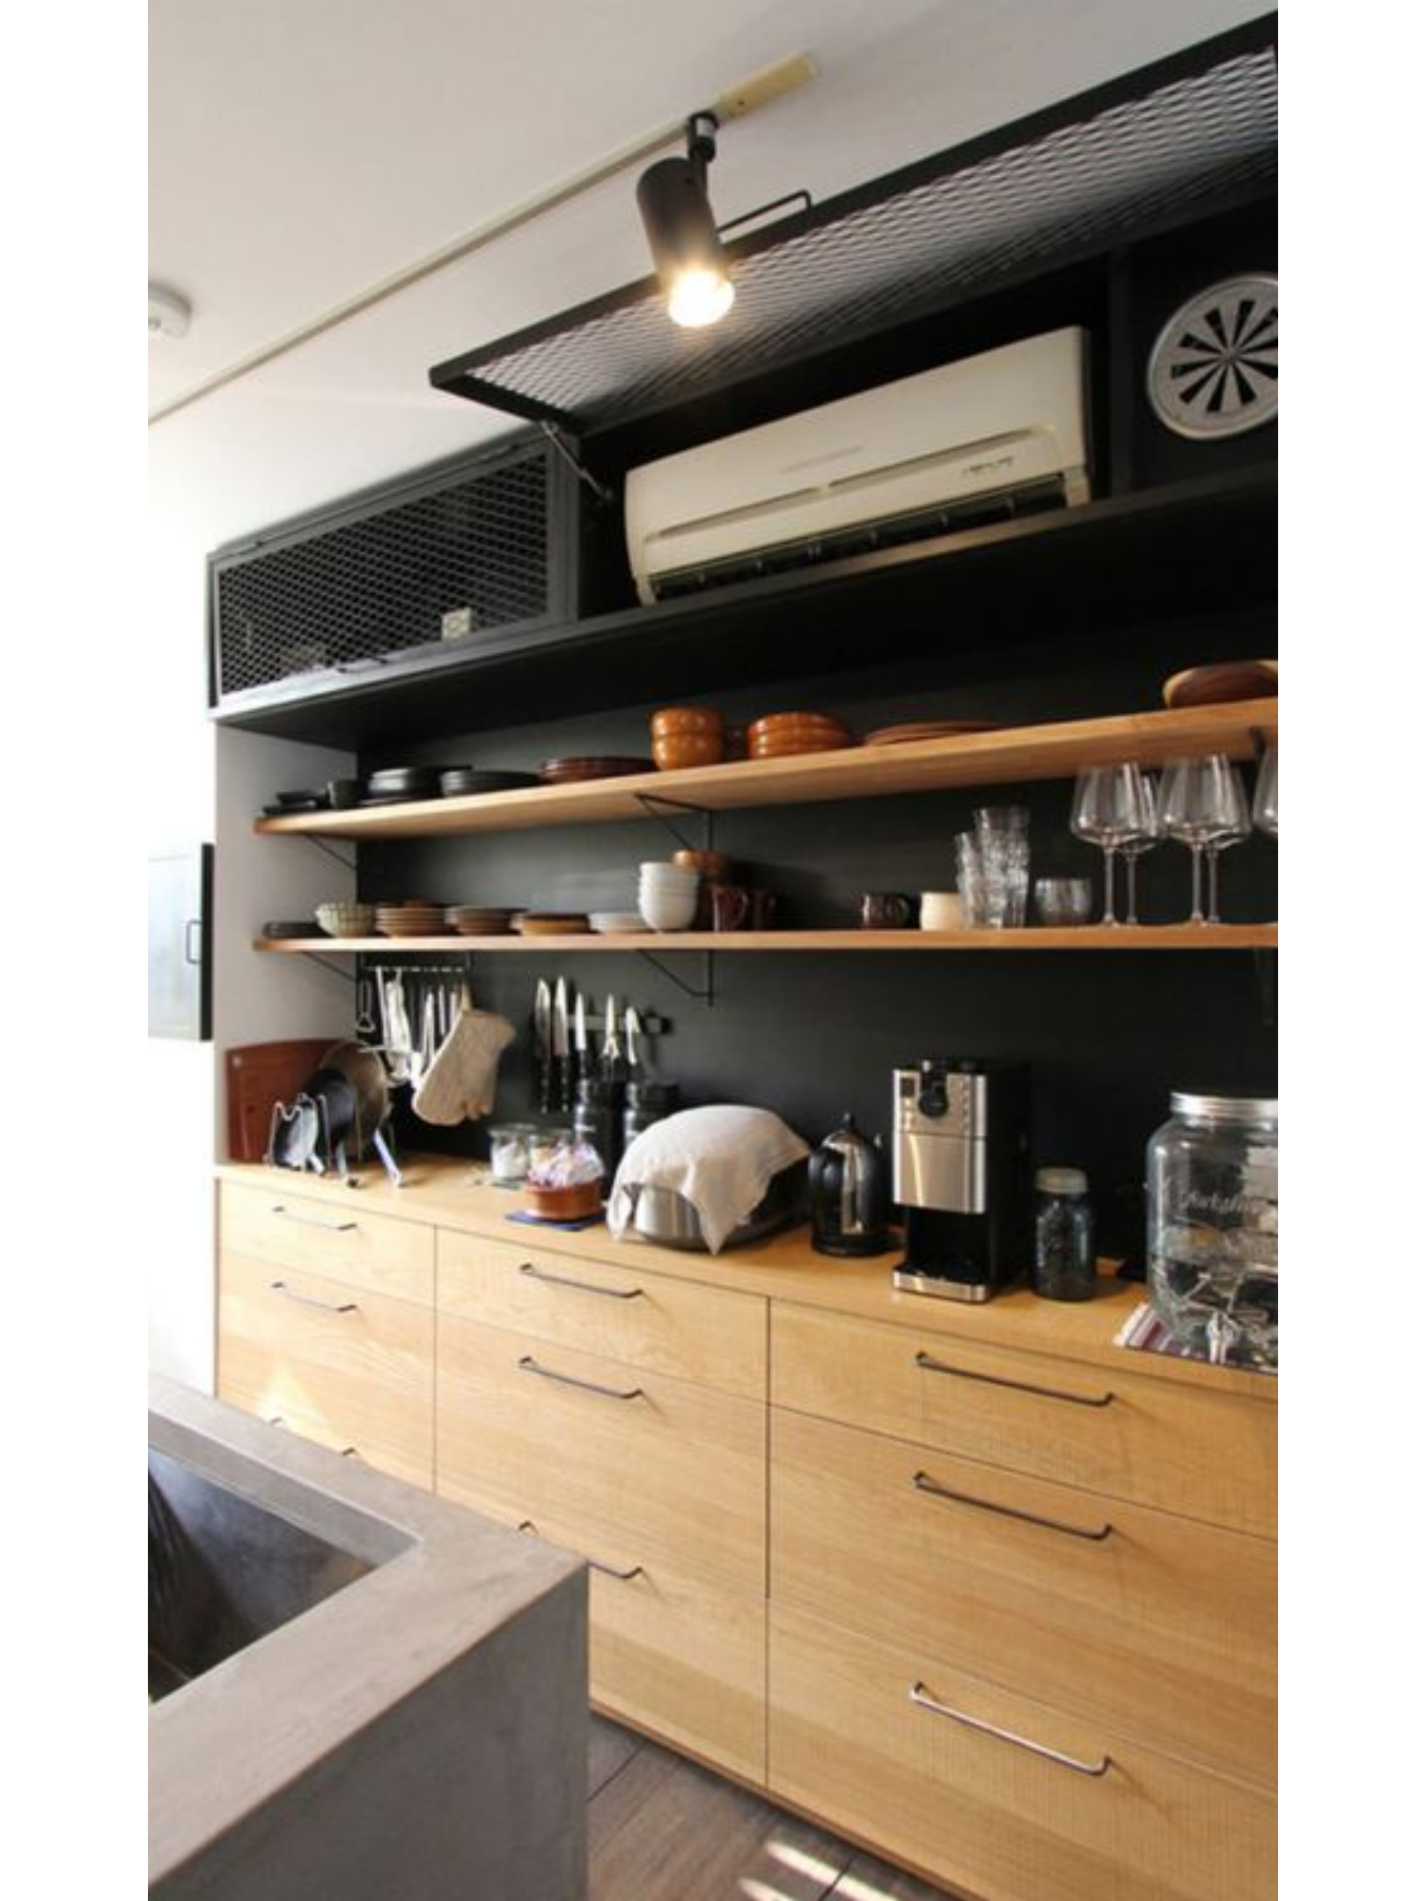
welcome
to
our
group
presentation

Slide 3
Group
5
Minh
Instructor:
Dang
Tuan
NGUYEN VAN
HOANG
NGUYEN DUC
NHAT ANH
NGUYEN THE
DAI
NGUYEN VAN
PHUOC
LUU TRINH
QUYEN
Leader
Deputy
leader
Member
Member
Member

Slide 4


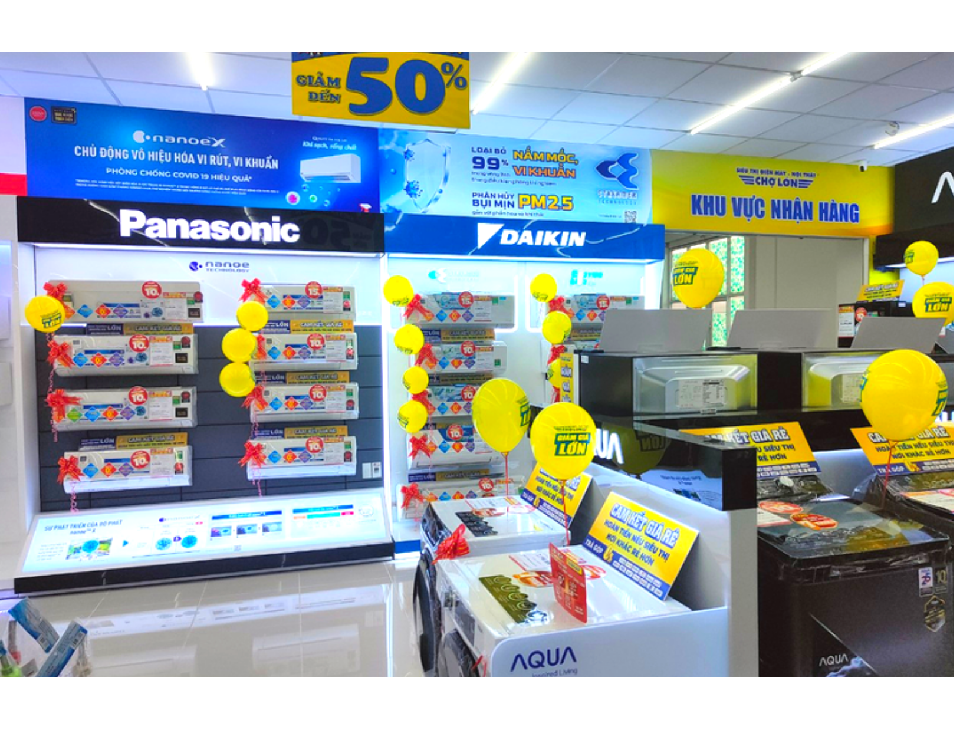
Product
advertisement
for
COSY
COSY company is selling air conditioners
of
famous brands such as LG, Panasonic, Funiki,
Daikin ,Samsung, .... Currently the company
needs to
products
- Make it
create a website to promote its
in order to:
easy for customers to access and learn
information about products quickly and
conveniently

Slide 5





COSY website is formatted in HTML and written
in
programming
languages
like
CSS,
javascript,
and
PHP.
Project: Product
advertisement for COSY

Slide 6

Website
The website will have a few functions as follows:
Function
1
Allows updating products to the database
2
Display a list of items by brand, each type.
3
The function of displaying and searching for
content and product information through the
article
search
section.
4
Function to receive and send feedback from
customers.
5
Product comparison function.
Project: Product advertisement for COSY

Slide 7

Admin's
Function
L O G LOGIN
I N
Product management (update, add, edit, delete)
P R O D U C T
M A N A G E M E N T
( U P D A T E ,
A D D ,
E D I T ,
product photo C T
P H O T O
M A N A G E M E N T
Receive customer feedback D B A C K
R E C E I V E

Slide 8


_{CUSTOMER}
_{FUNCTION}
_{FEEDBACK}
Customers can
comment
on
the
website
_{SEARCH}
_{FILTER}
Search for products
interest you
that
filter products by brand,
type you wants
_{VIEW}
_{S}
_{COMPARE}
_{D}
_{ETAIL}
Customers can see
details
Customers can compare 2
products with each other to make the best choice
about every product(price,
brand, type,..)

Slide 9
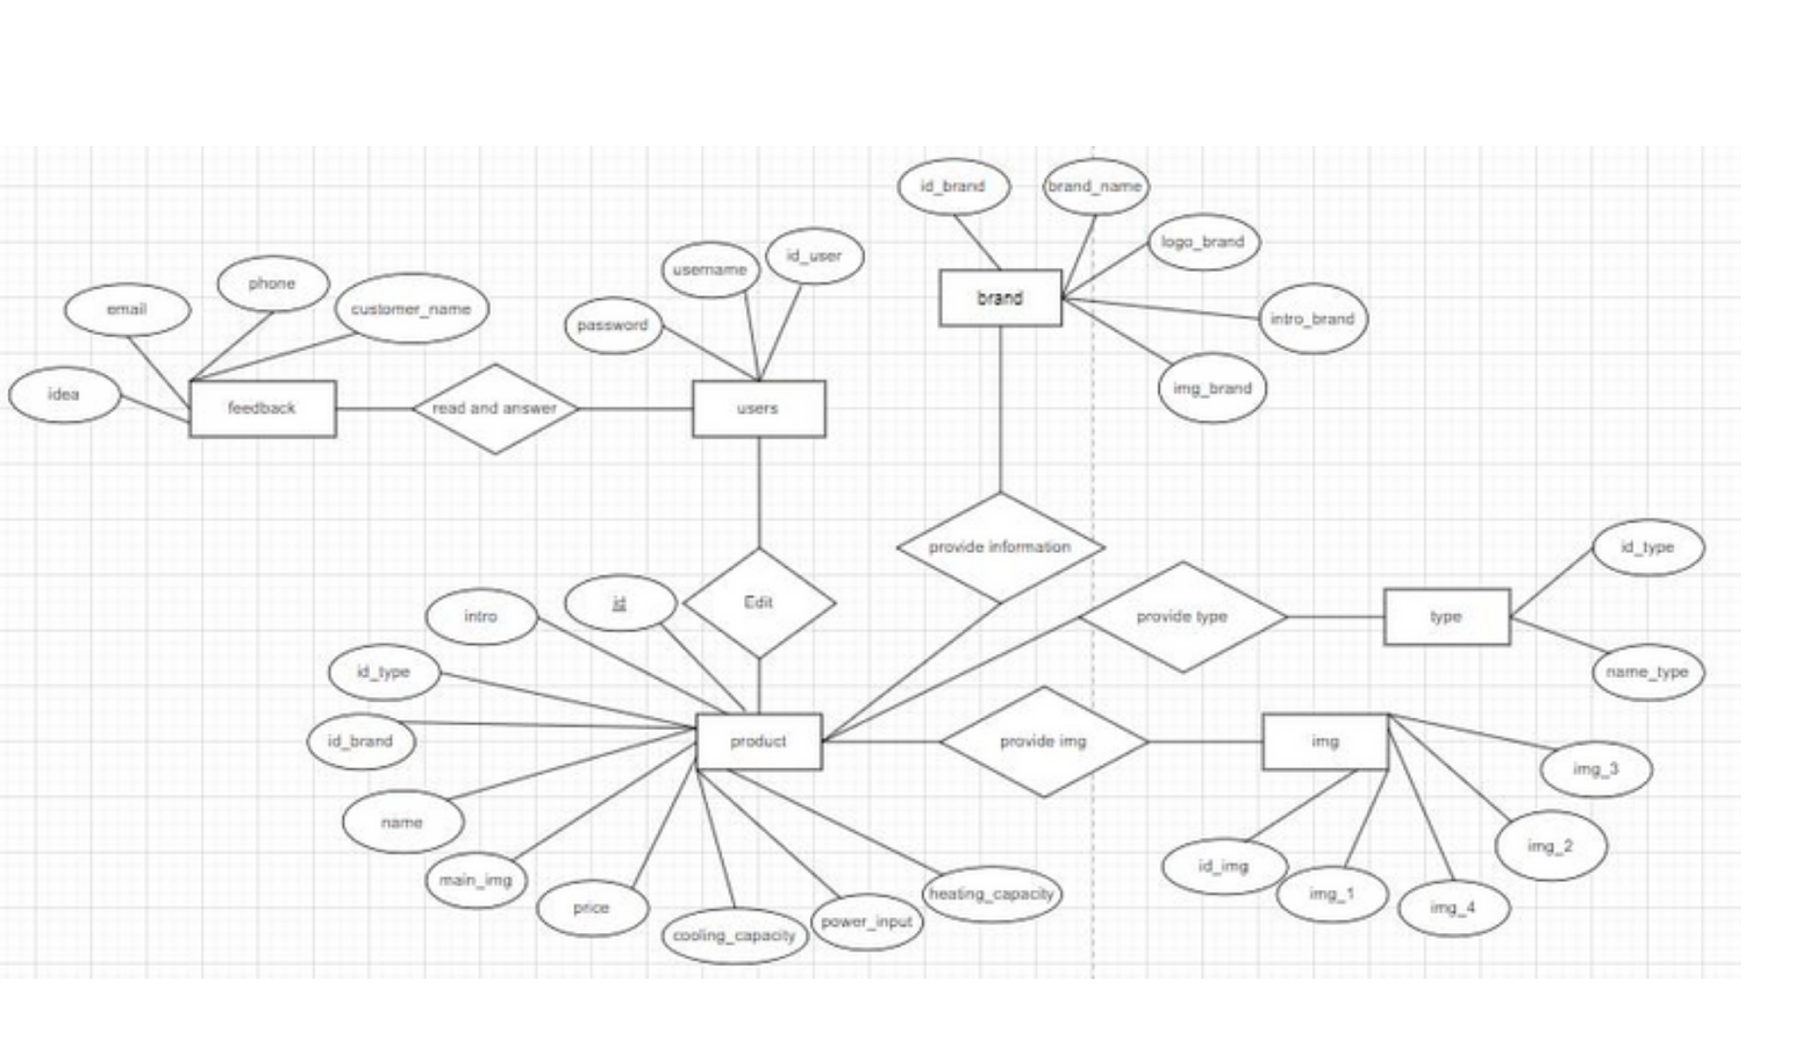
ERD

Slide 10
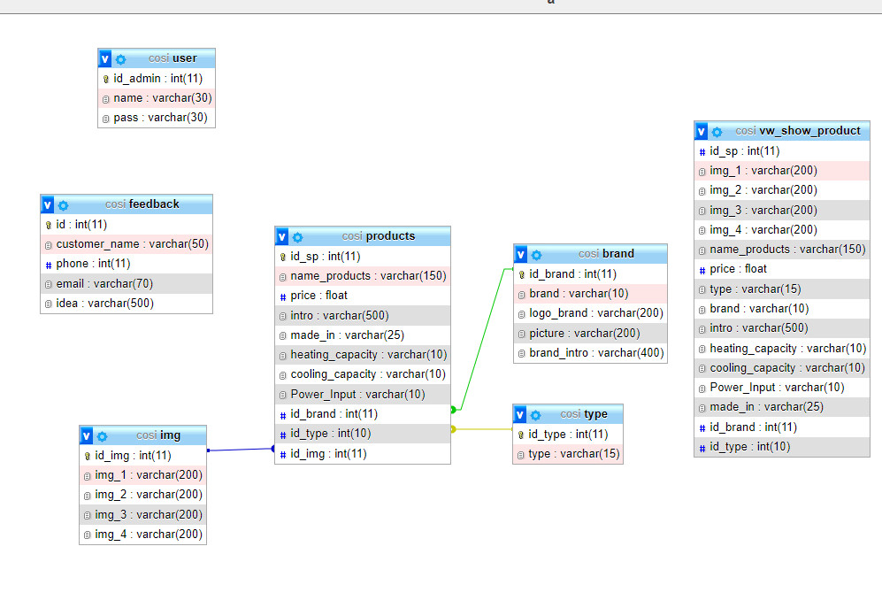
Database

Slide 11
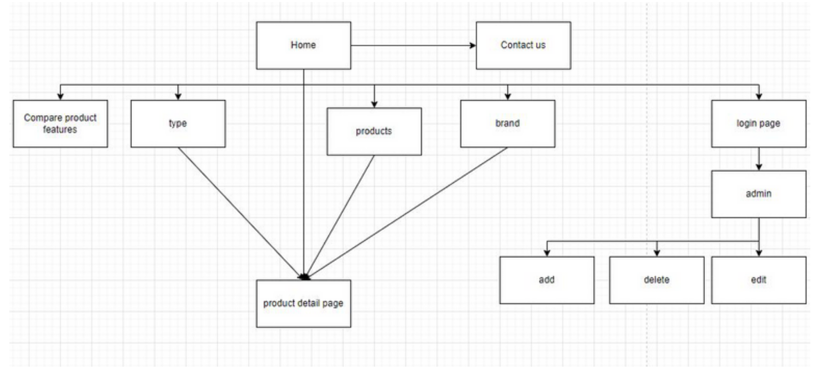
Site
Map

Slide 12
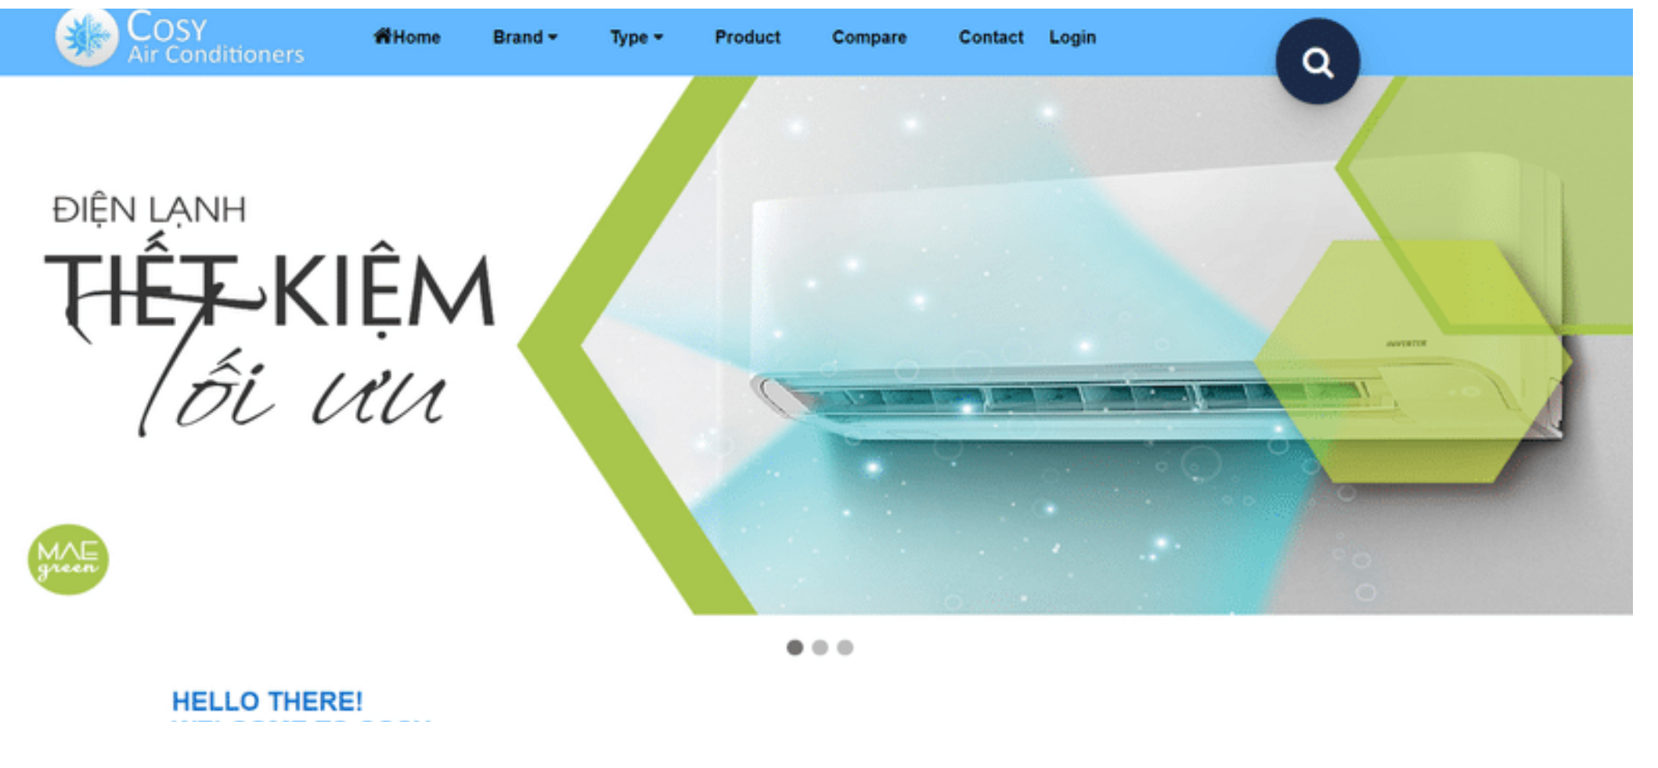
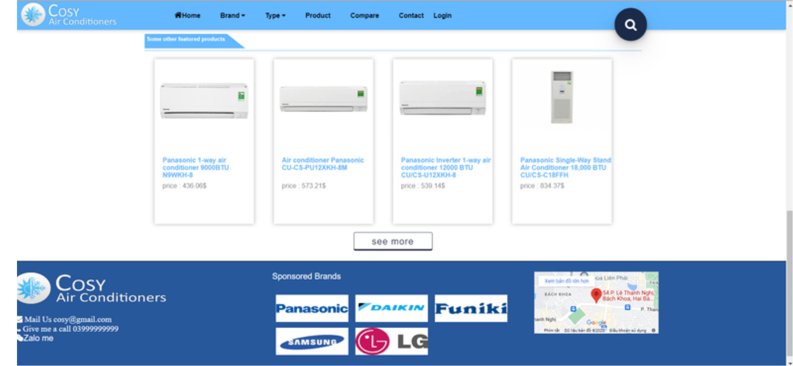
Homepage
The homepage is designed with a bright,
user-friendly interface to create
the
best
experience
when
using
the
web
In the footer, there is also full contact
information and address of COSY
company

Slide 13
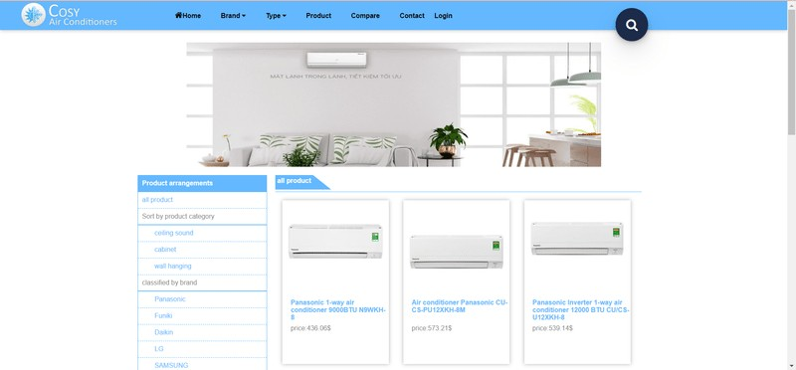
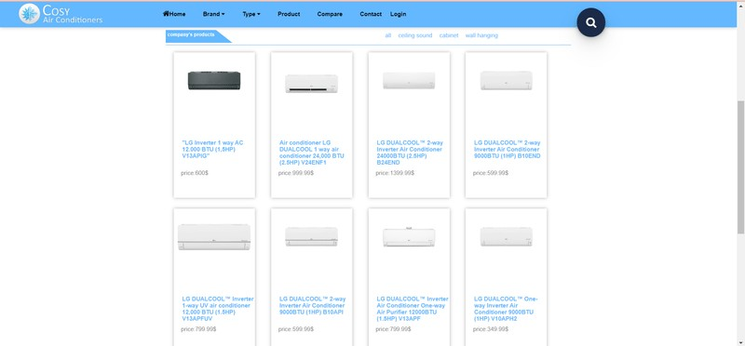
Products
page
Here
you
can
see
all
the
products
we
have
Or you can just
view the products
of
your favorite brands

Slide 14
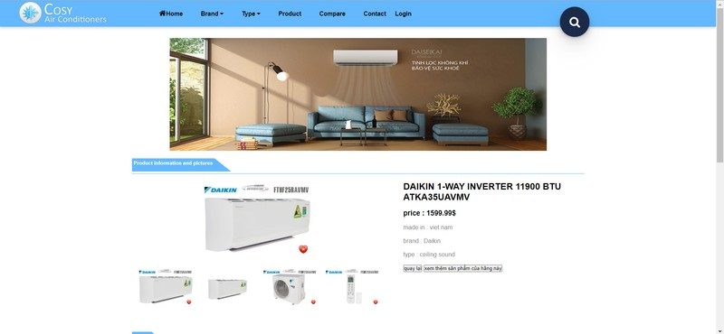
Product
details
This page will display the information that customers need to know about the product

Slide 15
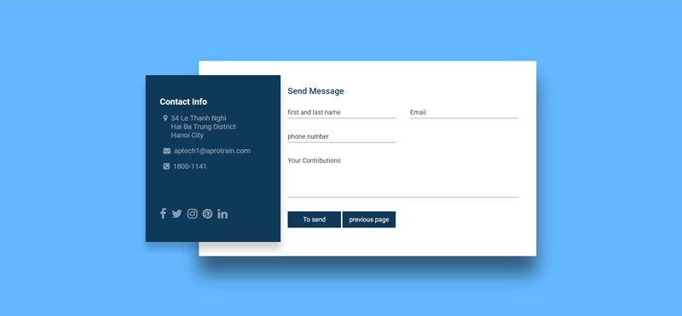
Contact
us
page
Company COSY

Slide 16
Planning
to
develop
a
website
in
the
future
Add
user
accounts
and
manage
user
accounts.
Add
the
function
of
selling
products
and
shopping
cart.
Develop
a
more
beautiful
and
convenient
web
interface.

Slide 17




_{COSY COMPANY}
_{THANK}
_{YOU}
FOR OUR
_{LISTENING}
_{TO}
bai bai
_{PRESENTATION}

